Slide 1
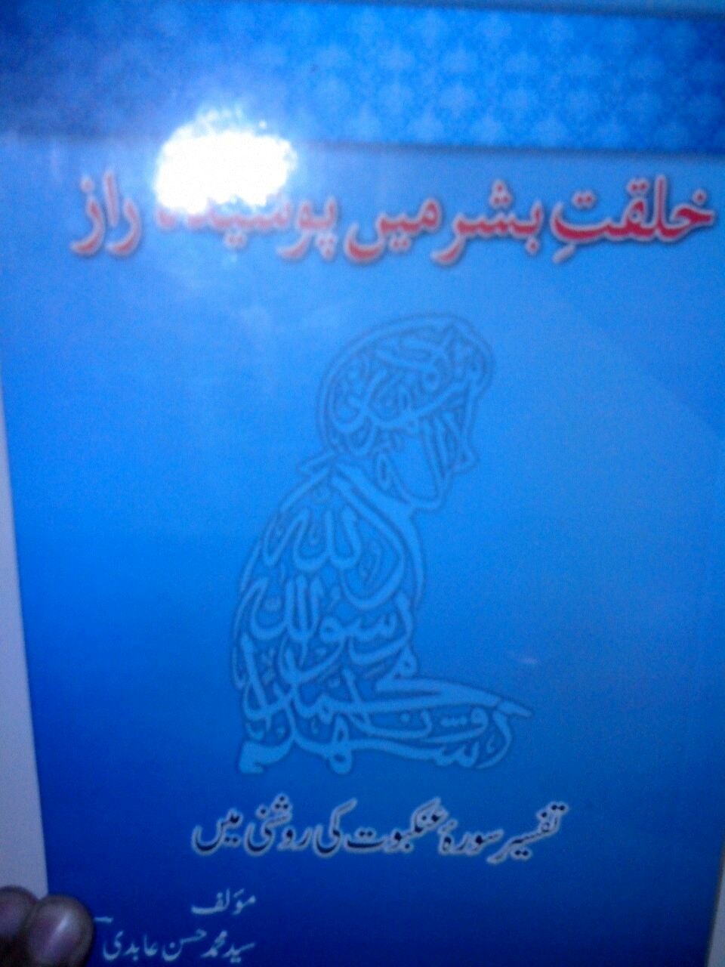
KHALQAT E BASHAR MEIN POSHIDA RAAZ
Syed Muhammad Hasan Abedi

Slide 2
Information About Book
Name: Kalqat e Bashar Mein Poshida Raaz
Writer: Syed Muhammad Hasan Abedi
Composing: Syed Muhammad Hadi(roh Ullah) Abedi
Publisher: Misbah Al Hadi Foundation
Quantity: 5000

Slide 3
Contents
Surae Ankaboot Ky Fazail
Surae Ankaboot Ka Naam Ankaboot Kyu Para?
Surae Ankaboot Mein Makri Ki Misaal Paish Karny Ky Asbaab
Kiya Sirf Momin Hona Kafi Hai?
Sachy Aur Jhoty Logo Ka Imtehaan
Quran Mein Fitna Ky Mani Aur Iqsam

Slide 4
Surae Ankaboot Kay Fazail
Hazrat Mohammad(s.a.w.w) ny farmaya
“Jo Bhi Surae Ankaboot Ki Tilawat Kary Ga Usky Namae Aamal Mein Tamam Momineen O Munafiqeen Ki Tadaad Ky Barabar Naikian Likh Di Jaen Gi.”
Imam Jafar Sadiq (a.s) farmaty hain
“Jo Bhi Ramzan Ki 23 Ki Shab Ko Surae Ankaboot Aur Surae Rome Ki Tilawat Kary Ga Tu Allah Ki Qasm Wo Ahle Bahist Mein Hoga”

Slide 5
Surae Ankaboot Ka Naam Ankaboot Kyu Para?
Ankaboot matlab makri ka jala
Hum tmhary gunah uthae gy
“hum ny insan ko hukm diya ky apny waledain ky sath naiki kary lekin agr wo tmhy shirk karny ki dawat karain tu tum ny bilkul unki ata`at nahi karni hai”
Pas ye sura un logo ky lieye nazil hui hai jo zaban sy emaan rakhty hain dil sy nae…
Imtehan lazmi hai farq ky lieye…
“taky Allah azmae ky kon apny adae emani mein sacha aur kn jhota “

Slide 6
Surae Ankaboot Mein Makri Ki Misaal Paish Karny Ky Asbaab
Kufaar ka aqeeda kamzoor hai jaisy makri ka jala
Lehaza Allah ky ilawa dosro ki ibadat karny walo ka aqeeda kamzor hai.
Hazrat Ali(a.s) ny farmaya
“apny gharo mein makri ky jaal ko door karo kyunky is ka rakhna ghr mein fikr o tang dasti lata hai”
Chunti apny sath 60 guna zyada wazan utha sakti hai.

Slide 7
Kiya Sirf Momin Hona Kafi Hai?
Tarjuma:
“Kiya Logo Ny Ye Guman Kar Rkha Hai Ky Wo Sirf Ye Kheny Sy Ky Hm Emaan Ly Aae Inhain Chor Diya Jaega Aur Unhain Azmaya Nae Jaega”
Is Ayat Mein Lafz Fitna Istemal Hua Hai

Slide 8
Kiya Sirf Momin Hona Kafi Hai?
Allah Ki Nisbat Sy Aur Insan Ki Taraf Nisbat Sy…
Tarjuma: ”Fitna Angezi Qatal Sy Zyada Sakht Hai”
“Kiya Wo Ye Nahi Dekhty Ky Unhain Har Saal Aik Do Martaba Azmaya Jata Hai Phr Usky Baad Bhi Toba Nahin Karty Aur Na Ibrat Hasil Karty Hai”

Slide 9
Sachy Aur Jhoty Logo Ka Imtehaan
Tarjuma:
“beshak hum ny un sy phely ky logo ka bhi imtehan liya hai aur Allah tu bhetr janna chahta hai ky in mein ko nsy loog sachy aurkon sy loog jhoty”
Is mein bazahir sirf umat e muslima ka imtehan hai …
Tarjuma:
“sonay ko aag mein dakhil karna taky asli sonay ko kharab sonay sy tashkhees di ja saky”

Slide 10
Quran Mein Fitna Ky Ma’ani Aur Iqsam
Kufr Ky Liye
Tarjuma:
“Beshak Inhon Ny Is Sy Pehly Bhi Fitny Ki Koshish Ki Thi Aur Tmhary Umoor Ko Palat Kar Dena Chaha Tha”

Slide 11
Quran Mein Fitna Ky Ma’ani Aur Iqsam
2. Azaab Ky Liye
Tarjuma:
“Kaha Jaega Ky Apny Fitno Ky Azaab Ko Chakho. Yehi Wo Azaab Hai Jis Ki Tum Log Jaldi Kiya Karty Thy

Slide 12
Quran Mein Fitna Ky Mani Aur Iqsam
3.Maal o Olad Ki Muhabbat
Tarjuma:
“Beshak Tum Logo Ka Maal o Olad Imtehan Ka Zarya Hai Aur Allah Ky Pas Boht Bara Ajar Hai”

Slide 13
Quran Mein Fitna Ky Ma’ani Aur Iqsam
4.Amraaz Ky Lieye
Tarjuma:
“Kiya Wo Nahi Dekhty Ky Unhain Har Saal Aik Do Martaba Bala Mein Mubtila Kiya Jata Hai Phir Is Ky Baad Nhi Toba Nae Karty Aur Na Ibrat Hasil Karty Hain”

